Slide 1


Group 1
Project presentation
Phytoplankton Air Systems
Dhairya Pal (N01576099)
Julian Imperial (N01638310)
Dharmik Shah (N01581796)
Sanskriti Mansotra (N01523183)
Algaerithms Inc.

Slide 2








Sanskriti M.
Dhairya P.
Scrum Master & Developer
Team Lead & Developer
Dharmik S.
Julian I.
Developer & Database Manager
Developer & Agile Support

Slide 3
What Distinguishes Our App
Nature-powered: Dashboard shows real-time oxygen conversion via live phytoplankton.
Educational: Insights screen promotes eco-literacy with curated videos and resources.
All-in-one Interface: Dashboard, FAB, and Notifications let users monitor, act, and stay updated.
Sustainable Loop: Service Request flow supports algae pod collection and reuse.
Gamified Experience: Leaderboard ranks users by oxygen produced — promoting climate engagement.
Trackable Growth: Achievements unlock based on milestones in purification and care.
User-first Design: Settings and Support screens ensure accessibility and in-app assistance.
Notes:
Our app stands out because it’s powered by real algae — not just code.
The Dashboard shows live oxygen conversion.
The Insights screen builds climate awareness.
It’s all-in-one — users can monitor, request service, and get alerts.
And we made it engaging — with leaderboards, achievements, and built-in support

Slide 4
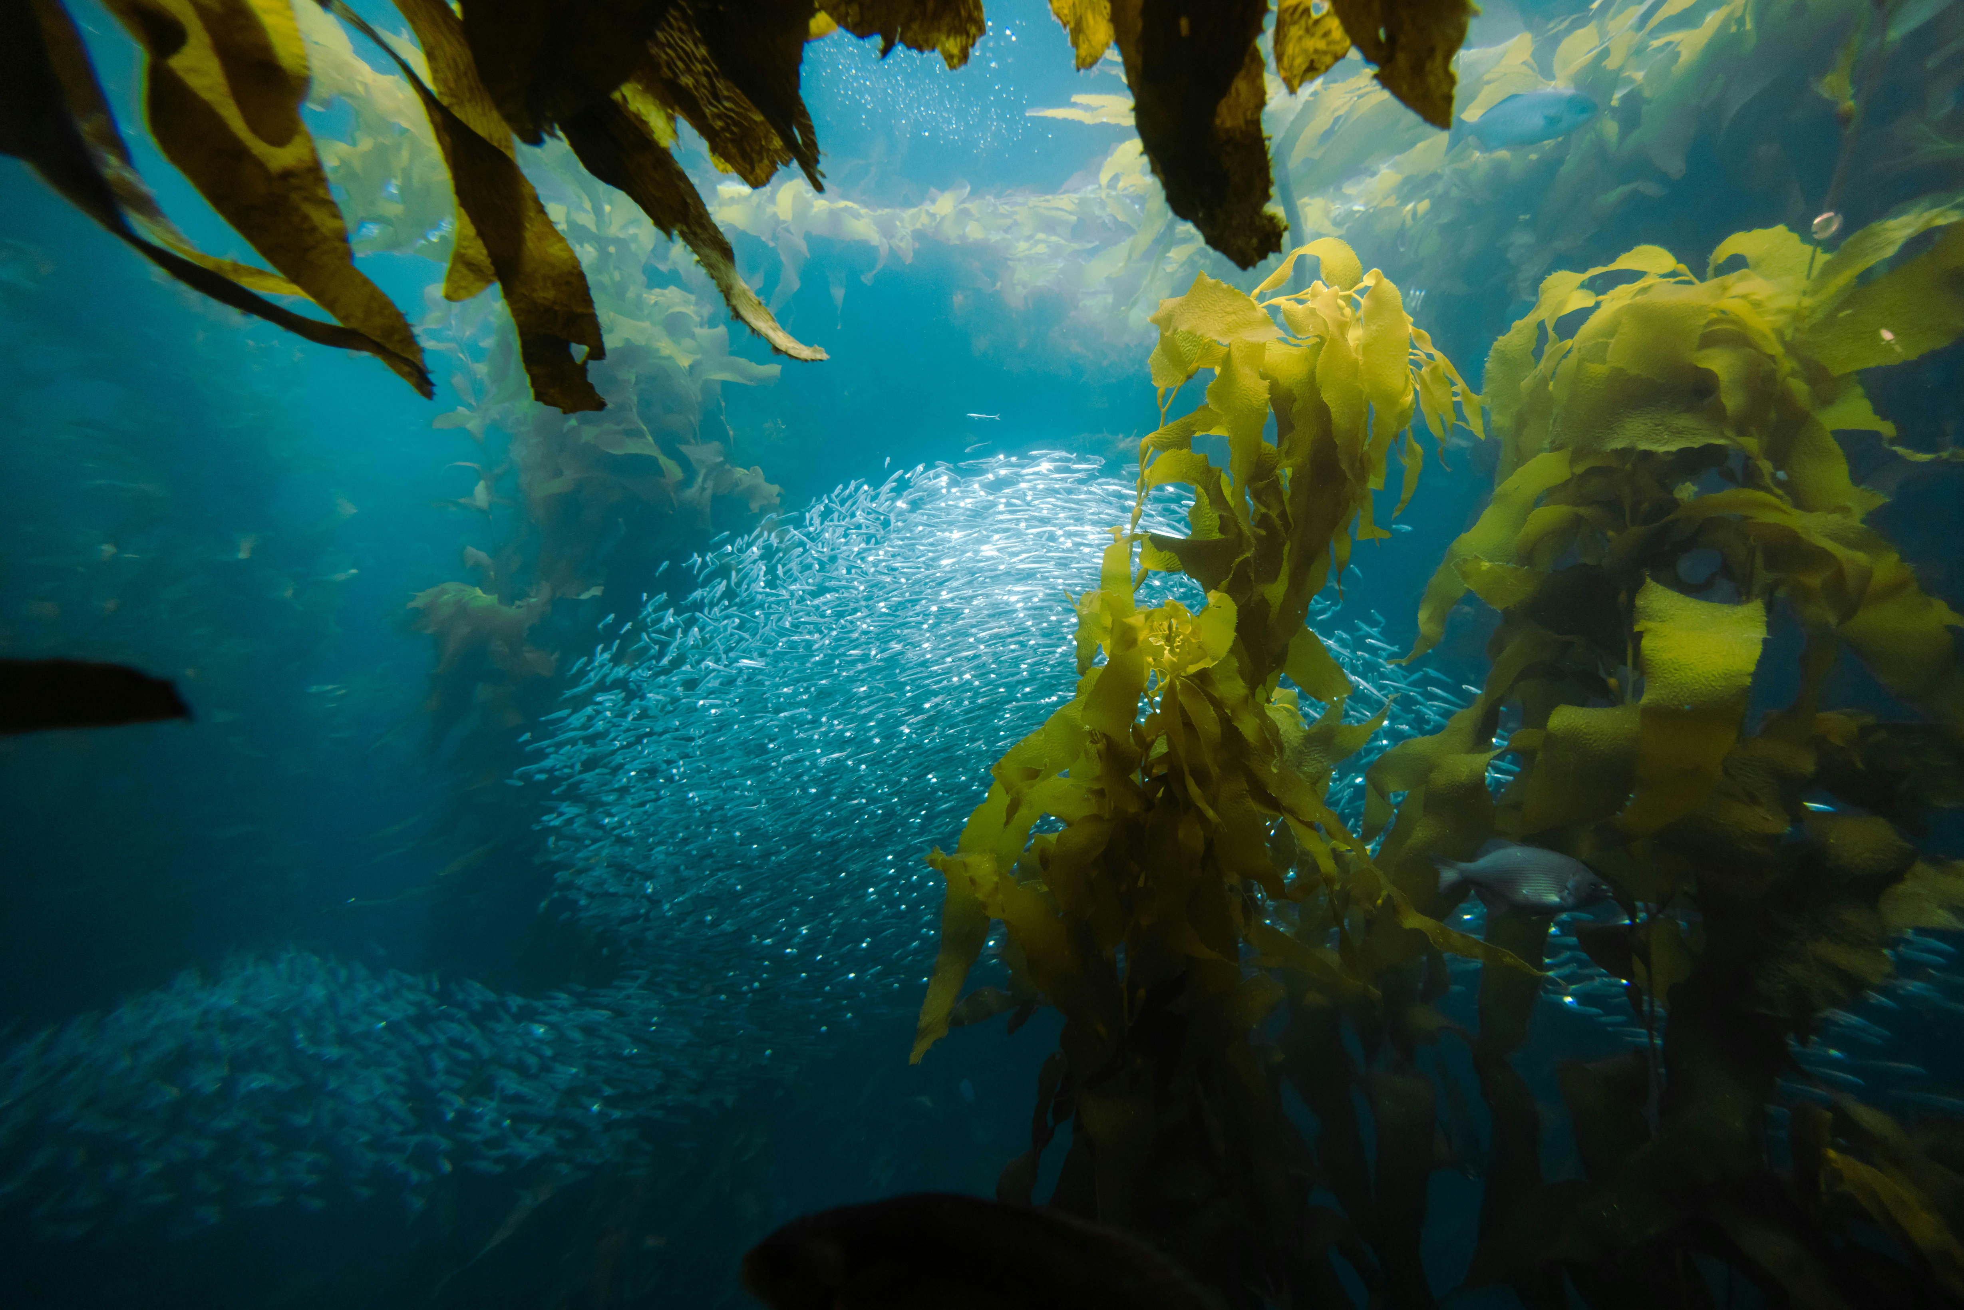
Why Our Project Breaks the Mold
Our project goes beyond typical app development — we integrated a real algae system to bring biology and tech together. We built for impact, not just function, adding a climate education screen, gamified tracking, and real-world service features. Every detail, from reusable algae pods to user-focused design, was made to create a product that’s sustainable, engaging, and built to last.
Notes:
Most capstone apps simulate features — we built a system that’s alive.
We combined tech with biology and education.
It’s not just functional — it teaches, motivates, and supports real action.
Everything from algae reuse to user flow was designed for real-world use.

Slide 5
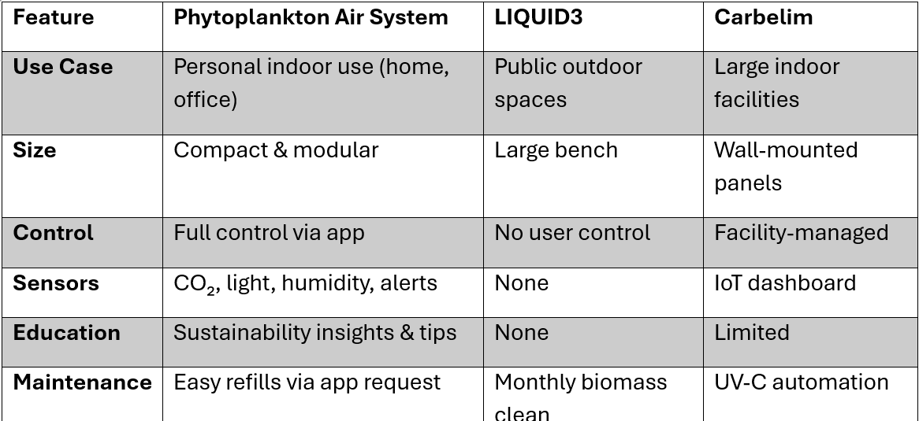
Market Comparison
Notes:
Compared to LIQUID3 and Carbelim, our system is smaller, smarter, and interactive.
Those are for cities and corporations — ours is for real people.
We offer full app control, education, and a personalized experience that’s both affordable and practical.

Slide 6
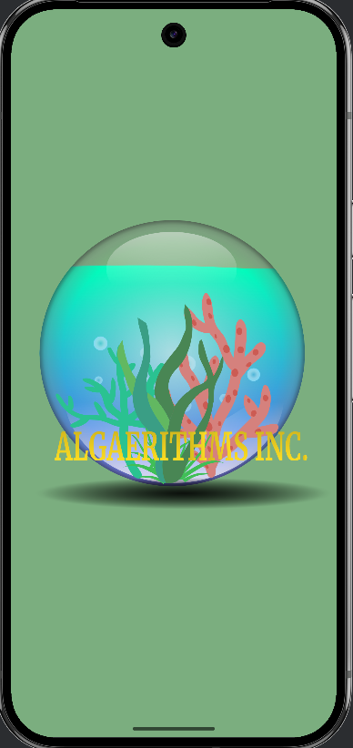
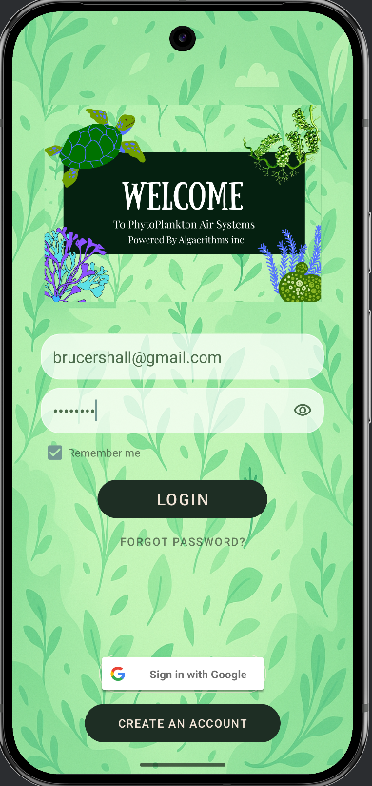
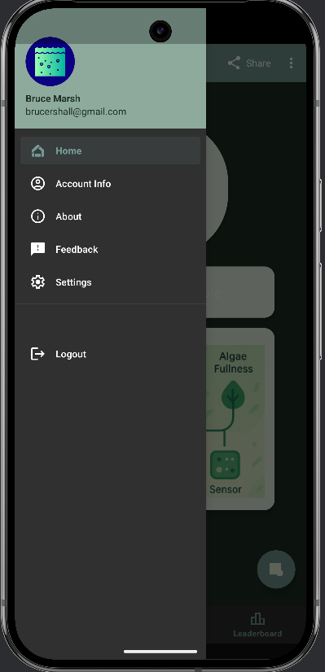
Flow of screens

Slide 7
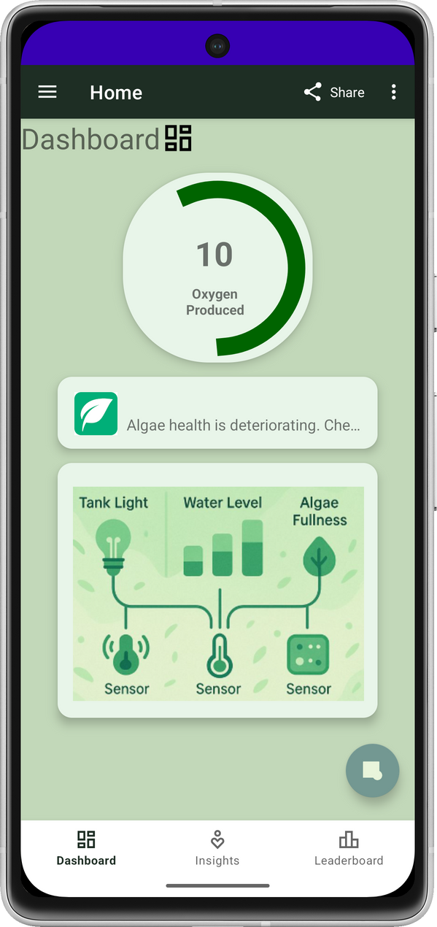
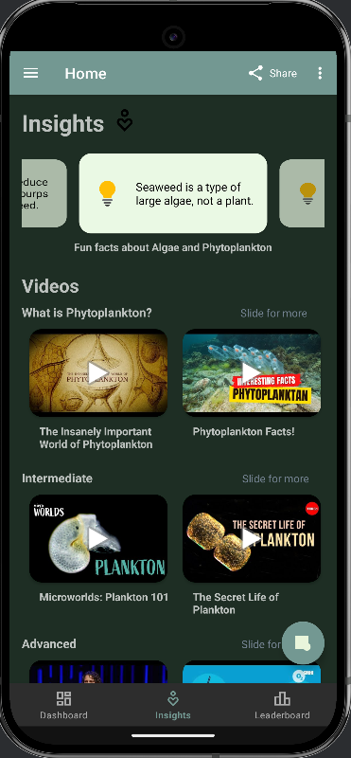
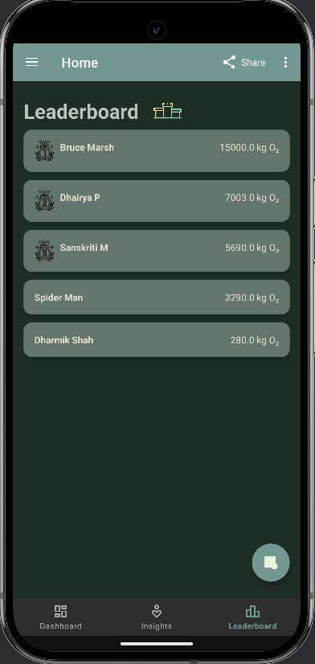

Slide 8
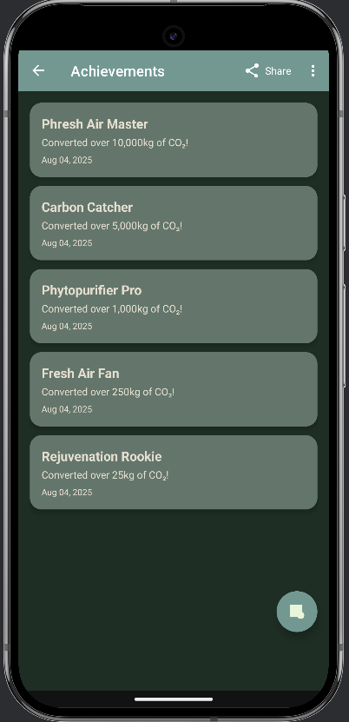
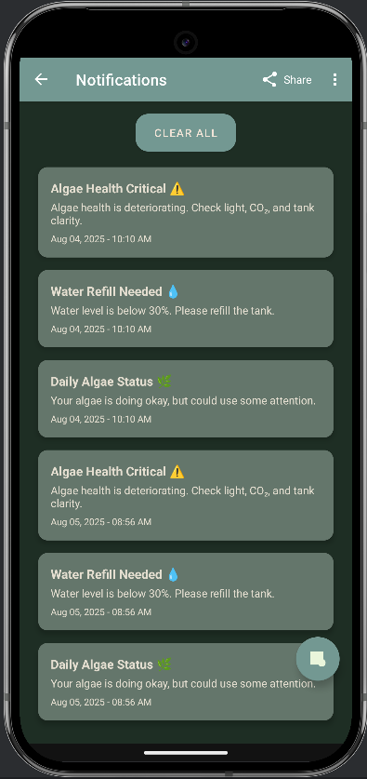
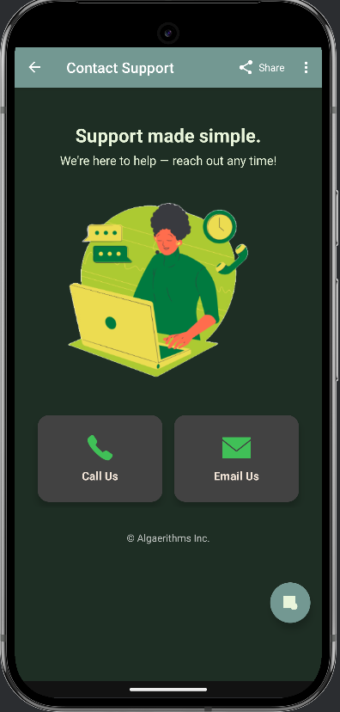

Slide 9
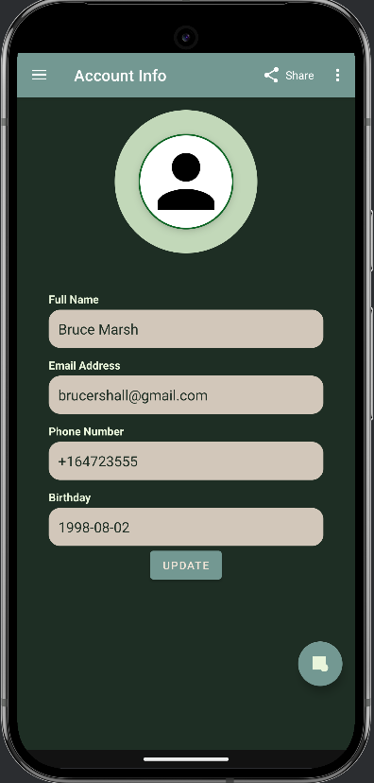
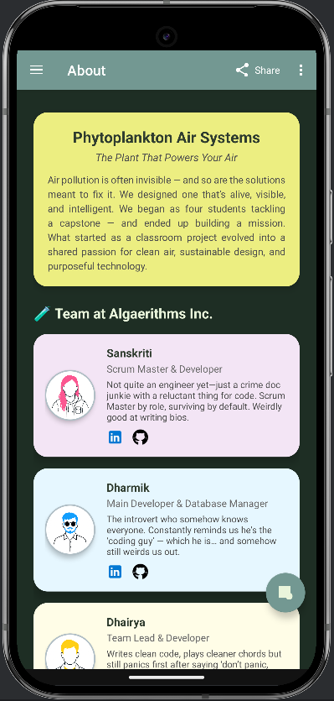
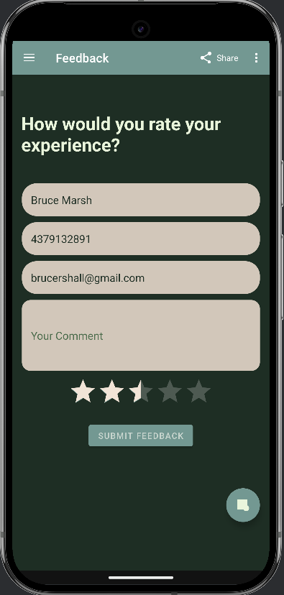

Slide 10
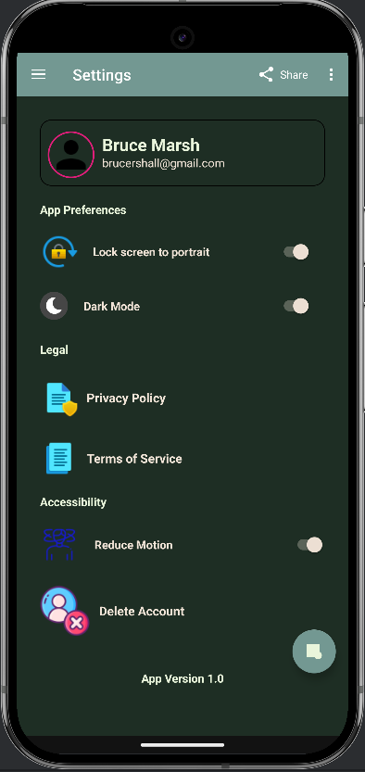
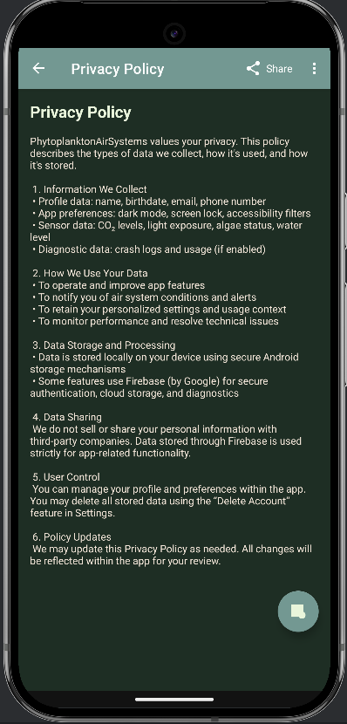
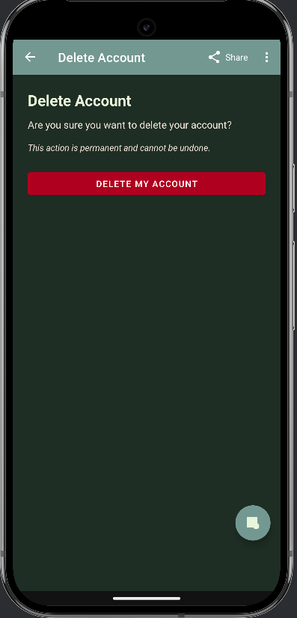

Slide 11
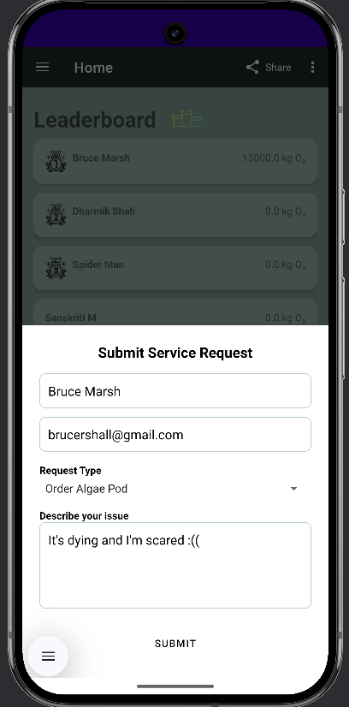
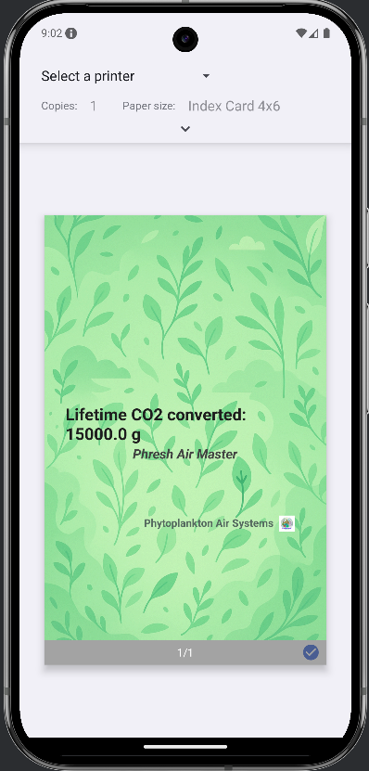

Slide 12
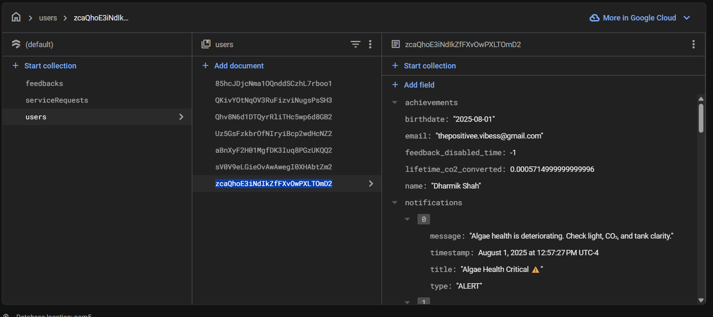
Database
https://console.firebase.google.com/project/phytoplankton-air-systems/overview

Slide 13
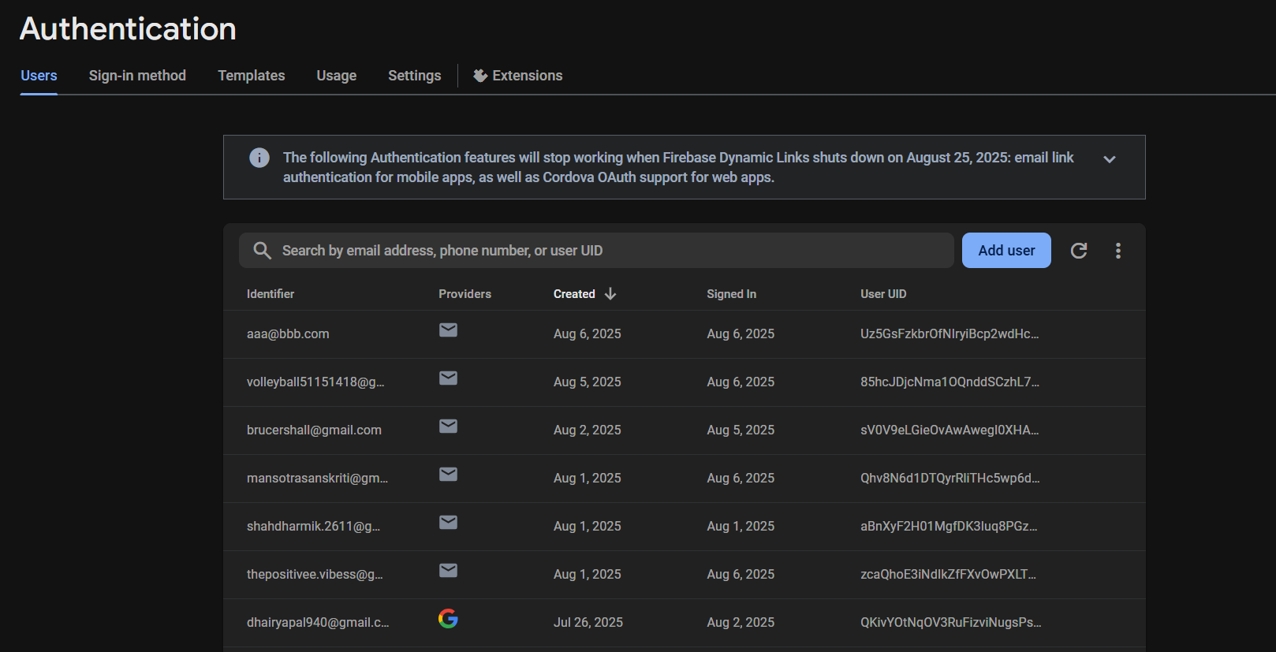
Database

Slide 14
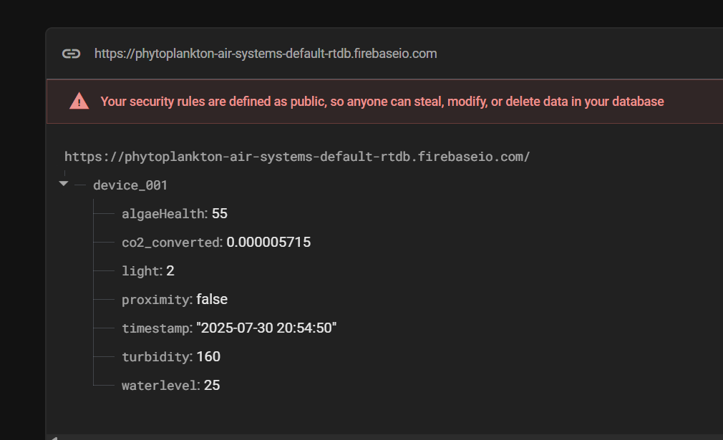
Database

Slide 15
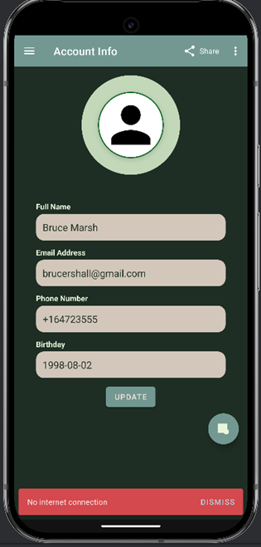
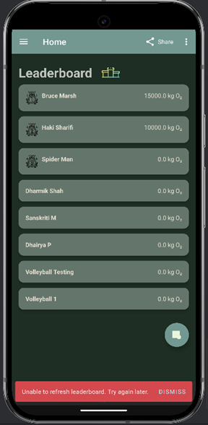
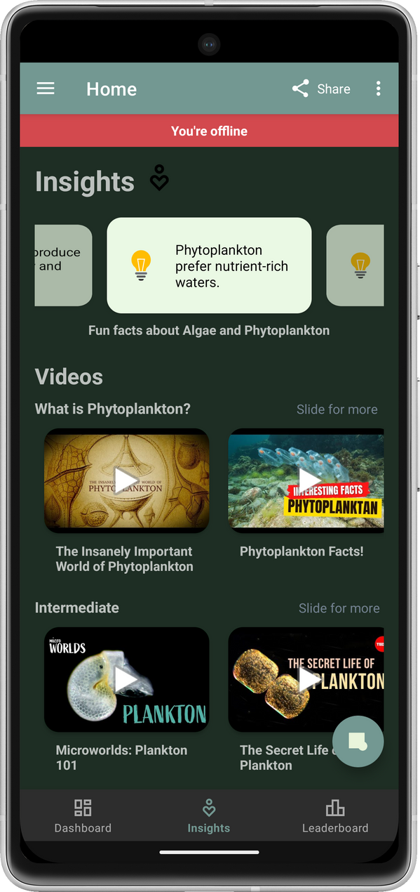
Offline Mode

Slide 16
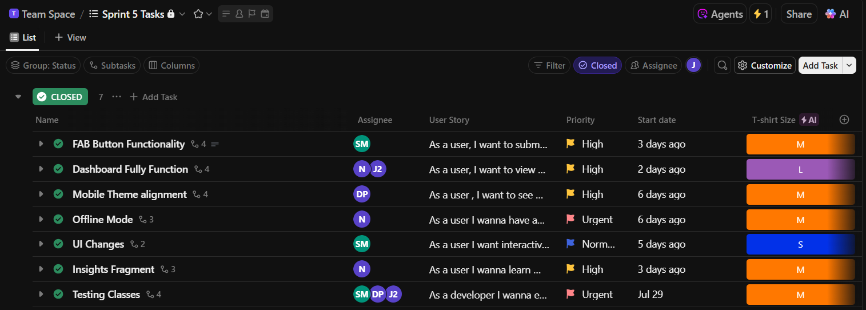
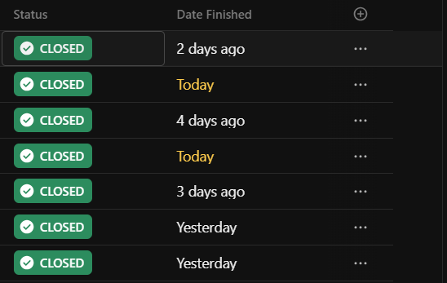
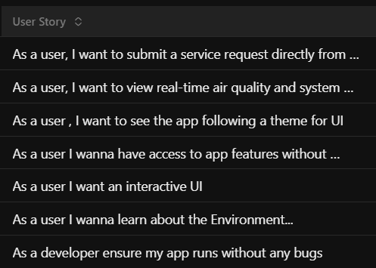
Driven by Sprints. Delivered by Synergy.
Sprint 5 Tasks
Notes:
Tshirt sizing
DoD
maybe include an example of one of the stories and the tasks within it

Slide 17
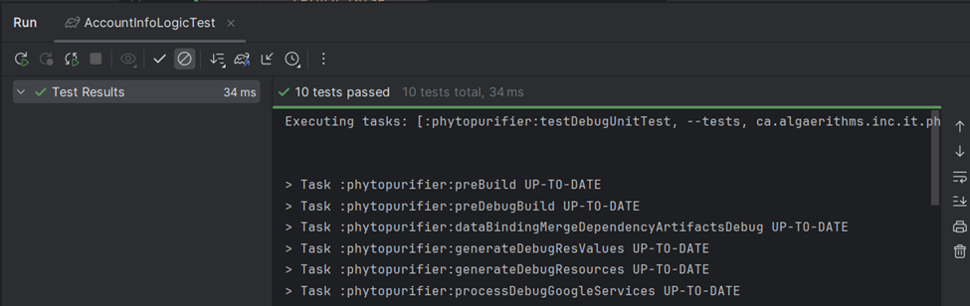
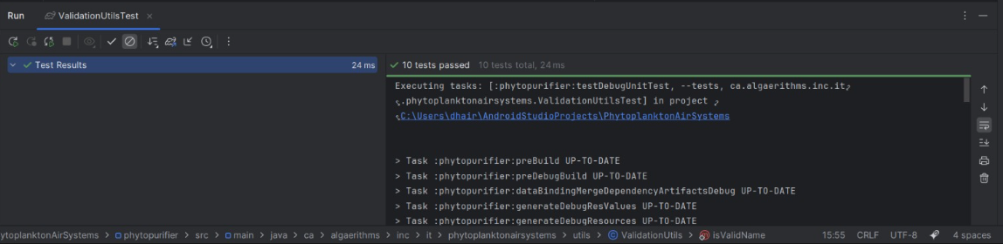
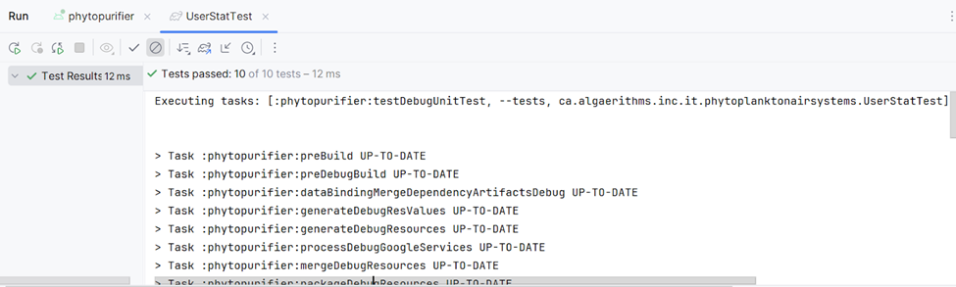
Junit Testing

Slide 18
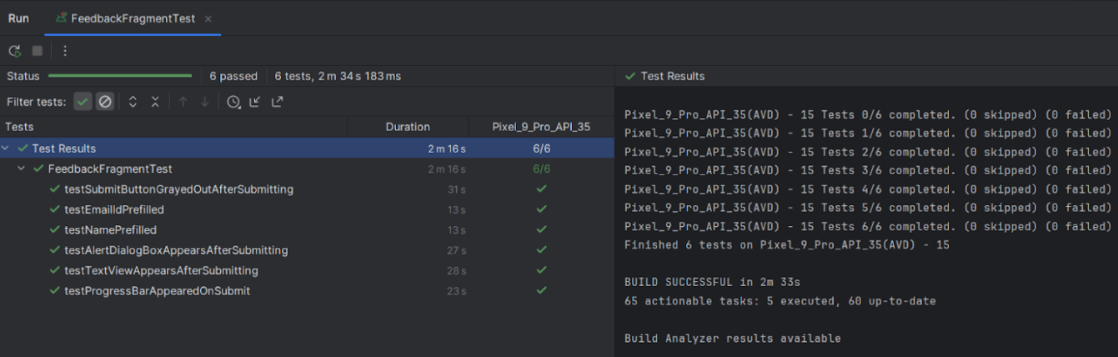
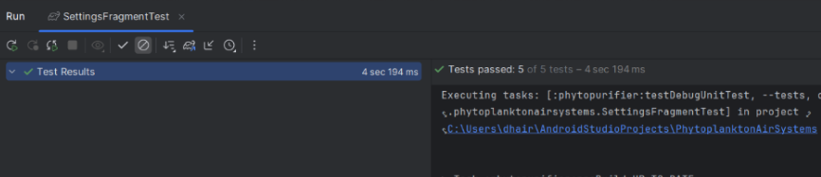
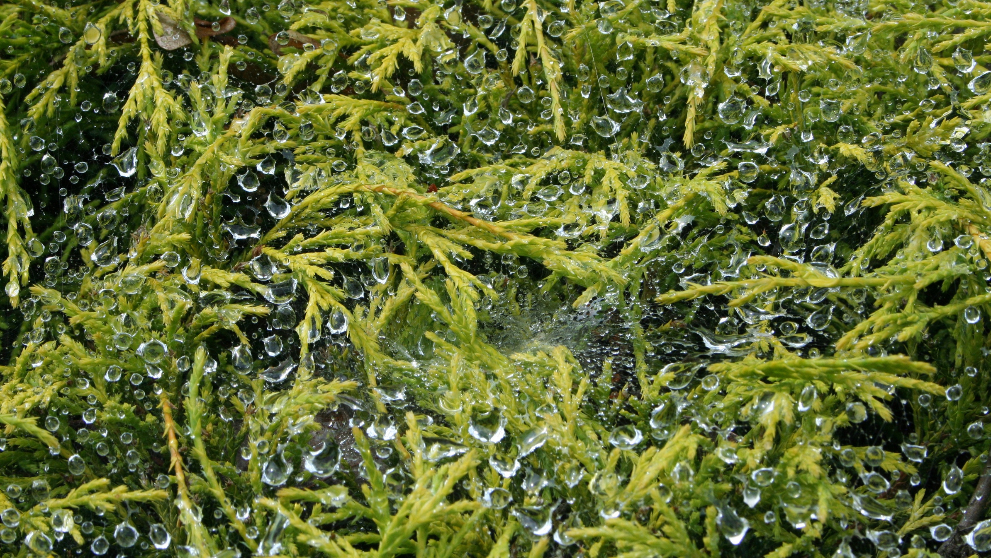
Espresso and Robleteric Testing

Slide 19
CENG322 Software Project
Thank you
Algaerithms Inc.

Slide 20


